Slide 1
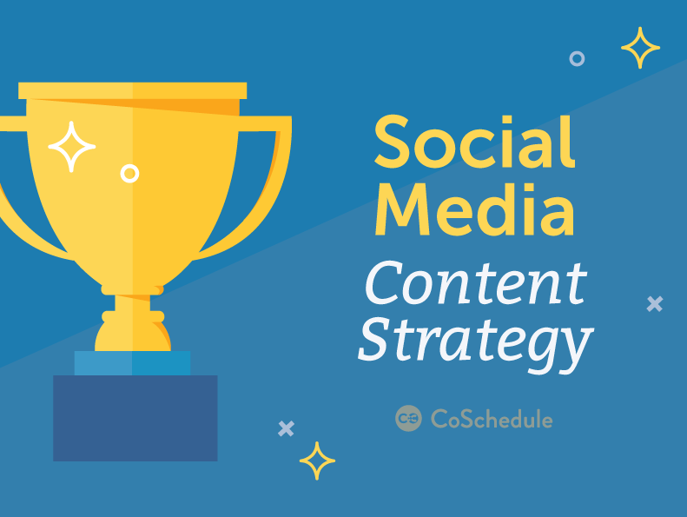

Slide 2
Table Of Contents
Establish Goals
Social Media Audit
Establish Your Target Audience
Competitive Analysis
Establish Brand Voice & Tone
Build Your Social Media Content Strategy
Social Media Marketing Measurement

Slide 3
How To Use This Template
This template is best used as a companion to our blog post titled How To Develop A Winning Social Media Content Strategy:
http://www.coschedule.com/blog/social-media-content-strategy-template
Use the post linked above as a reference point to complete this template. By the time you’re done, you’ll have a fully documented content strategy for your social media marketing efforts.

Slide 4
Step 1: Establish Goals

Slide 5
Understand Why You’re On Social Media
Knowing what you want to achieve on social media is the first step toward success. Identify business objectives social media can help you achieve. Then, list social objectives that support those goals.
Business Objectives | Social Objectives

Slide 6
Establish Specific Goals
Describe the challenges you face, why your goals are important, and how you intend to achieve them …
Goal | Deadline

Slide 7
Step 2: Social Media Audit

Slide 8
3-Step Social Media Audit
Which social media networks are we on? List them:
List abandoned accounts to remove (if any):
List duplicate accounts to merge (if any):

Slide 9
Social Media Account Inventory
Network | URL | Active? (Y/N) | Fan/Follower # | Notes

Slide 10
Step 3: Establish Your Target Audience

Slide 11
Build Your Persona (Slide 1 of 2)
Persona Name:
Job Title:
Age:
Gender:
Income Level:
Location:
Interests & Hobbies:

Slide 12
Build Your Persona (Slide 2 of 2)
Challenges & Aspirations:
Favorite Blogs & News Sources:
Persona Summary
[Insert one or two paragraph character summary here. How would your target customer or audience member describe themselves?]
Customer Quote
[Insert a real quote from a real customer that represents something your persona might say]

Slide 13
Step 4: Competitive Analysis

Slide 14
Competitive Inventory
Competitor Name | URL | Notes

Slide 15
Top Ten Competitor Analysis (Fans/Followers)
Competitor | Facebook | Twitter | LinkedIn | Google+ | Pinterest

Slide 16
How Can You Out-Do Your Competition?
What We Can Do Better
What We Can Do Differently
List what you can do better than your competition
List what you can do differently than you competition

Slide 17
Step 5: Establish Brand Voice & Tone

Slide 18
Brand Voice Description
Social Media Tag Line (3 words to describe your social brand voice):
[INSERT ADJECTIVE 1]
[INSERT ADJECTIVE 2]
[INSERT ADJECTIVE 3]
Social Media Mission Statement:
[INSERT YOUR BRAND] creates social content to [INSERT BENEFIT] for [INSERT AUDIENCE].
Describe your brand’s voice and personality here:

Slide 19
Step 6: Social Media Content Strategy

Slide 20
Content Curation Source List
Trusted Content Sources
List trusted sources you’ll share content from …
Source Name | Source URL

Slide 21
What Social Media Content Will We Create?
Content Types We Will Create:
List here ….
Content Types We Will Curate:
List here ...

Slide 22
What Purpose Will Our Content Serve?
Original Content
[ ] Entertain
[ ] Inform
[ ] Promote products/services
[ ] Promote content (blog posts, ebooks, landing pages, etc).
[ ] Promote partners
[ ] Promote contests
Curated Content
[ ] Entertain
[ ] Inform
[ ] Promote products/services
[ ] Promote content (blog posts, ebooks, landing pages, etc).
[ ] Promote partners
[ ] Promote contests

Slide 23
Social Media Posting Frequency
Network | Posts Per Day | Posts Per Week
Facebook
Twitter
Google+
Pinterest
LinkedIn
Instagram

Slide 24
Social Media Calendar Strategy
List upcoming events, product launches, and important dates to add to your content calendar:
[ ]
[ ]
[ ]
[ ]
[ ]
[ ]
[ ]
[ ]
[ ]
Our content calendar will include:
[Insert %] Original Content (Informative)
[Insert %] Original Content (Promotional)
[Insert %] Curated Content

Slide 25
Step 7: Social Media Marketing Measurement

Slide 26
Choose Which Metrics To Monitor
Facebook [ ] Likes [ ] Shares [ ] Comments [ ] Clicks [ ] Engagement Rate [ ] Referral Traffic [ ] Video Views [ ] Conversions | Instagram [ ] Follower Count [ ] Likes [ ] Comments [ ] Referral Traffic
Twitter [ ] Likes [ ] Retweets [ ] Replies [ ] Referral Traffic [ ] Conversions | Pinterest [ ] Repins [ ] Referral Traffic [ ] Conversions
LinkedIn [ ] Likes [ ] Comments [ ] Replies [ ] Referrals [ ] Conversions | Google+ [ ] Followers [ ] +1’s [ ] Referrals [ ] Conversions [ ] Comments [ ] Shares

Slide 27
Measurement Checklists
Key Metrics (list):
[ ] Configured Google Analytics to track social media traffic and conversions
[ ] Configured other third-party social media analytics tools
[ ]

Slide 28
90-Day Progress
Network | Page Likes / Followers | % Growth | Referral Traffic | Conversions
Facebook
Twitter
LinkedIn
Google+
Pinterest
Instagram

Slide 29
Notes & Findings
What went well with our strategy?
What went wrong with our strategy?
How can we improve our strategy?

